Slide 1
ENDOMYOCARDIAL FIBROSIS
Dr saidalavi T

Slide 2
Commonest form of endemic restrictive cardiomyopathy of unknown origin in the tropical and subtropical regions
Dense acellular fibro-collagen tissue deposition underneath the endothelial layer of the endocardium , inflow tracts, and the apices of right ventricle, left ventricle, or both
Reduced ventricular cavity size leading to restriction of the ventricular filling.
Notes:
commonest form of endemic restrictive cardiomyopathy of unknown origin in the tropical and subtropical regions of the world that is characterized by dense acellular fibro-collagen tissue deposition underneath the endothelial layer of the endocardium and, to a lesser extent, in the myocardium, in the inflow tracts, and the apices of right ventricle, left ventricle, or both resulting in reduced ventricular cavity size leading to restriction of the ventricular filling.

Slide 3
Enigmatic disease
Specific endocardial involvements
Localization to certain geographical pockets
Propensity to affect the poor
Typical endocardial calcification
Notes:
Difficult to understand
The Historically, one of the most intriguing aspects of the disease is its peculiar occurrence in certain pockets of the world
isease has some peculiar features which are not not explained til now

Slide 4
JNP Davies first coined the term endomyocardial fibrosis (EMF) while working in Uganda
Disease came to be known as the Davies’ disease
Characterized by fibrosis of the apical endocardium of the right ventricle (RV), left ventricle (LV), or both
In endemic areas of Africa, EMF is a main cause of heart failure, comparable to RHD
Notes:
JNP Davies first coined the term endomyocardial fibrosis (EMF) while working in Uganda and said that “he became convinced rightly or wrongly that he had met a new disease”6. He also discussed the initial clinical description of the disease by Bedford and Constam in 19467.

Slide 5
EPIDEMIOLOGY
EMF was first recognized in Uganda in 1940s
Accounts for as much as 20 percent of cardiac cases in that country
EMF is estimated to be the most common form of restrictive cardiomyopathy worldwide
Sliwa K, Damasceno A, Mayosi BM. Epidemiology and etiology of cardiomyopathy in Africa. Circulation 2005; 112:3577
Confined to a few geographically specific locations within 15° of the equator.
EMF also occurs in subtropical regions

Slide 6
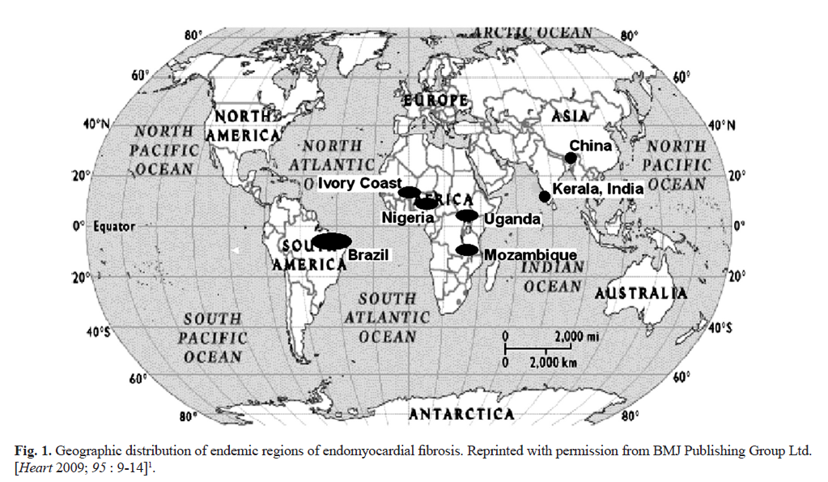
Notes:
Uganda, Nigeria, and Mozambique. The disease is increasingly recognized in other tropical and subtropical regions within 15 degrees of the equator, including India, Brazil, Colombia, and Sri Lanka.^{[52]} Importantly, it is also recognized in the Middle East, particularly Saudi Arabia

Slide 7
Primarily a disease of the young
Occurring in children, adolescents and young adults who belong to the poorer sections of society
In Uganda, a bimodal peak at ages 10 and 30 has been observed
Differences between genders in the frequency of disease have been variable

Slide 8
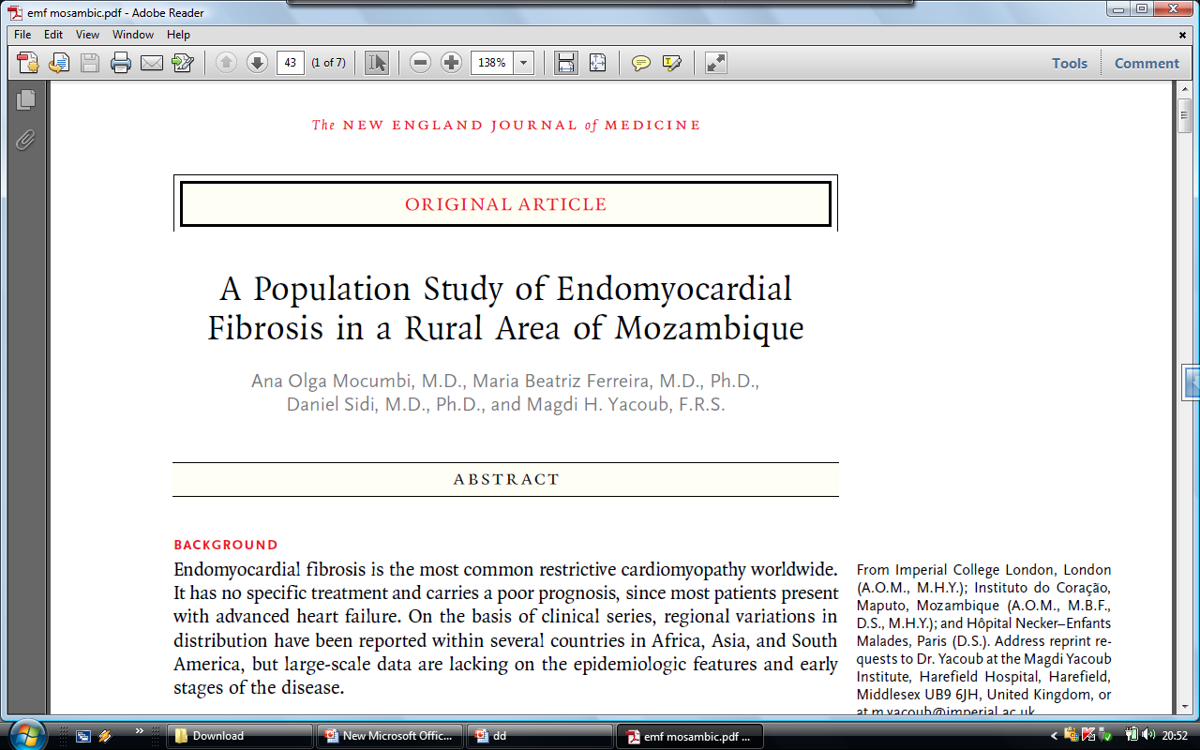

Slide 9
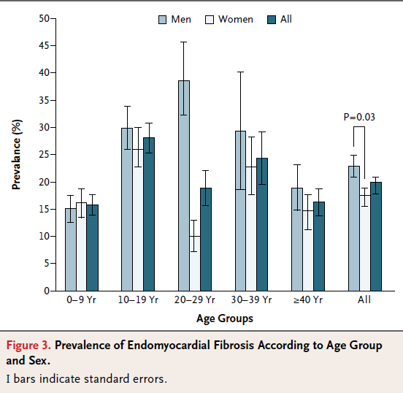
Overall prevalence was 19.8%
Highest among persons
10 to 19 years of age (28.1%)
Higher among male than among
female subjects (23.0% vs. 17.5%)
Most common form was
biventricular EMF( 55.5%)
Followed by right sided EMF (28.0%)
Only 48 persons with EMF (22.7%)
were symptomatic

Slide 10
In India its prevalence is highest in Kerala with very few cases reported from northern India
Kerala was once ‘the hot spot’ for this enigmatic disease
The epidemiology of endomyocardial disease, is a ‘vanishing mystery’ in the southern districts of India especially in the coastal belt of Kerala state
Notes:
CK Gopi, in 1962, from Trivandrum, described the specimen kept in the hospital autopsied in 1950s as a case of right ventricular endomyocardial fibrosis with right atrial thrombi1

Slide 11
PATHOPHYSIOLOGY
Cause of the underlying fibrotic process of EMF is largely unknown
Major hypotheses
  Eosinophilia
  Infectious
  Environmental exposure
  Malnutrition
  Immunologic
  Genetic
  Toxic agents
Notes:
Malnutrition Protein deficiency [79]
Magnesium deficiency [23]
Toxic agents Cerium [23]
Cassava [79,91]
Thorium [

Slide 12
Eosinophilia
Most commonly cited etiologic link in EMF
EMF resembles a late stage of Loeffler's endocarditis - result from sustained eosinophilia in hypereosinophilic syndrome
EMF and intraventricular thrombosis have also been observed following a variety of other eosinophilic syndromes
  hypersensitivity myocarditis
  parasitic infections
  eosinophilic leukemia
  prolonged drug-induced eosinophilia
Notes:
In support of the eosinophilia theory is the observation that (eosinophilic myocarditis)

Slide 13
Eosinophilia
One study from Uganda found that 60 percent of patients with EMF had at least mild eosinophilia at the time of diagnosis compared to 10 percent of controls
Freers J, Masembe V, Schmauz R, Endomyocardial fibrosis syndrome in Uganda. Lancet 2000; 355:1994
Serum and myocardial eosinophilia have not been consistently demonstrated in EMF
In Kerala most with EMF did not have active eosinophilia at the time of diagnosis
Valiathan SM, Kartha CC. Endomyocardial fibrosis--connexion with myocardial levels of magnesium and cerium. Int J Cardiol 1990; 28:1
Endomyocardial biopsies have not demonstrated eosinophilia in EMF
Patel AK, Ziegler JL, D'Arbela PG, Somers K. Familial cases of endomyocardial fibrosis in Uganda. Br Med J 1971; 4:331
Notes:
It is possible that many with EMF have had significant eosinophilia at one time that is not detected by the time of presentation to medical care

Slide 14
Infectious
Several infections have been implicated in the pathophysiology of EMF
  Toxoplasmosis
  Rheumatic fever
  Malaria and helminthic parasites
A consistent association with one organism, however, has not been demonstrated
Many tropical countries with similar burdens of malaria and filariasis as Uganda and Nigeria do not have reported cases of EMF

Slide 15
Environmental exposure
Cerium, a rare earth element, has been postulated to play a role in the pathogenesis of EMF
Cerium is abundant in the soil in areas endemic for the disease and has been shown to induce myocardial fibrosis in rodents
Valiathan SM, Kartha CC. Endomyocardial fibrosis--the possible connexion with myocardial levels of magnesium and cerium. Int J Cardiol 1990; 28:1
Serum levels of cerium are high in patients with EMF compared to controls, and it is postulated that cerium is ingested from food and contaminated soil
Eapen JT, Kartha CC, Rathinam K, Valiathan MS. Levels of cerium in the tissues of rats fed a magnesium-restricted and cerium-adulterated diet. Bull Environ Contam Toxicol 1996; 56:178.
Incidence of EMF is decreasing in India, which corresponds with a reduction in soil cerium that has occurred with modernization
Sivasankaran S. Restrictive cardiomyopathy in India: the story of a vanishing mystery. Heart 2009; 95:9

Slide 16
Immunologic
  anti-myosin autoantibodies has been demonstrated in EMF
Malnutrition
  Protein deficiency
  Magnesium deficiency
Toxic agents - Cassava
Genetic
  A familial link has been identified in many studies; however, it is not known whether this is due to an environmental or genetic cause or both

Slide 17
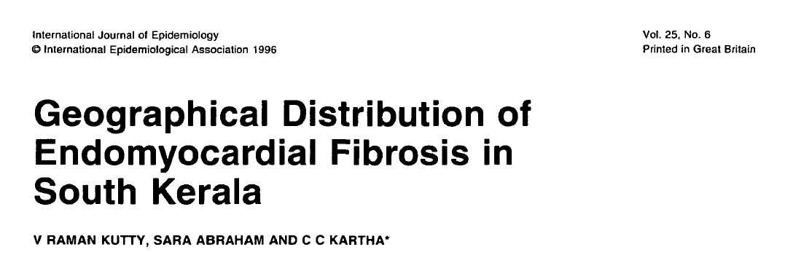
Background
  To find out whether pattern of distribution of EMF in south Kerala in India is consistent with geochemical hypothesis

Slide 18
Patients from south Kerala who had a confirmed diagnosis of EMF during the period 1978-1994
Results - identified an area of high density of EMF comprising four taluks near the coastline situated within the districts of Alapuzha, Kollam, and Pathanamthitta
Two coastal taluks in Kollam and Alapuzha districts are known areas of deposits of monazite elements in the state
Geographical distribution is not related to prevalence of filariasis and eosinophilia
Conclusion - Coexistence of high density of occurrence of EMF and deposits of monazite elements support the geochemical hypothesis
Notes:
High content of lanthanides in the soil in these regions generated a new geochemical hypothesis on the generation of this disease33,56. The high content of cerium in the diet which is fibrogenic for the heart, and the process is exacerbated because of the magnesium deficiency occurring in children because of malnutrition and diarrhoeal disorders

Slide 19
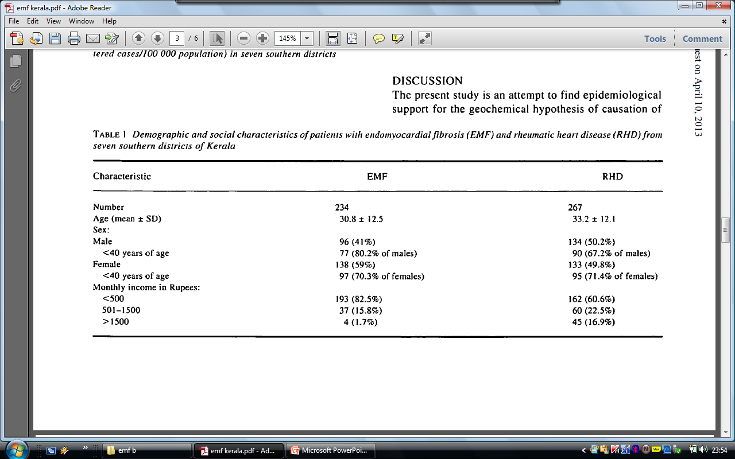

Slide 20
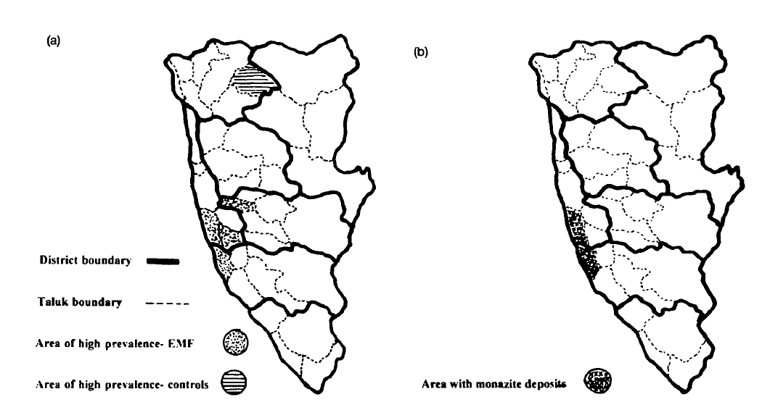
Seven southern districts of Kerala with (a) areas of high density of occurrence of endomyocardial fibrosis (EMF) (b) areas with deposits of monazite

Slide 21
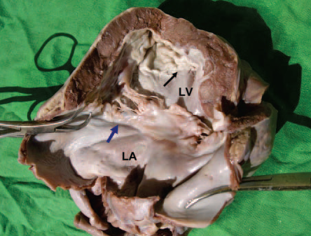
PATHOLOGY
Fibrosis of the right and/or left apical endocardial surfaces which leads to restrictive physiology
Tethering of the AV valve papillary muscles leads to significant AV valve regurgitation
Atrium of the affected ventricle is often dramatically enlarged
No primary involvement
of extra-cardiac organs
In LVEMF fibrosis extends from
apex to PML usually sparing AML
Notes:
Postmortem heart specimen of a young boy who died
as a result of severe mitral regurgitation caused by left-sided
EMF. Black arrow indicates scar at the apex of the left ventricle.
Note that the left ventricle is small and the left atrium is
enlarged and the retracted posterior leaflet of the mitral valve is
involved in the fibrotic process (blue arrow).

Slide 22
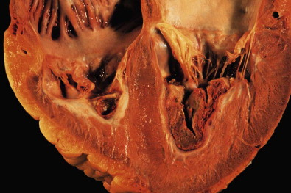
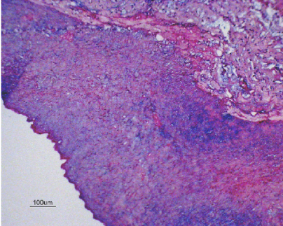
Gross pathology reveals ventricular endocardial thickening and fibrosis often with overlying thrombus
Histopathology demonstrates
  increased type I collagen deposition
  subendocardial infarction
  fibrosis and thrombus
Notes:
Severe irregular endocardial thickening is shown in photomicrography of a ventricle affected by
advanced endomyocardial fibrosis

Slide 23
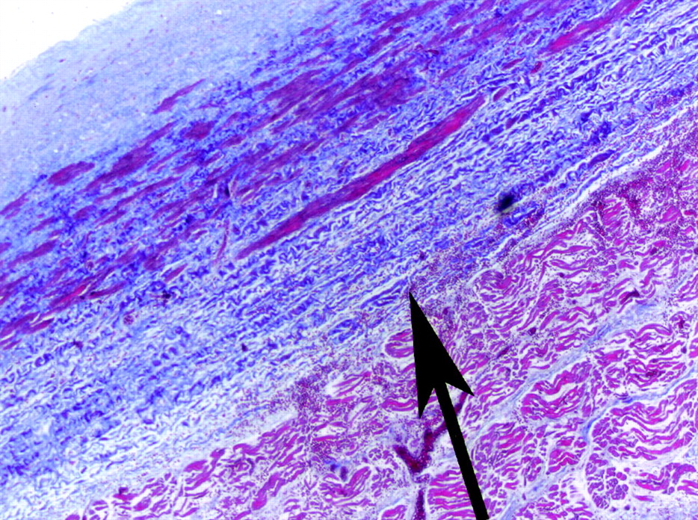

marked fibrotic thickening of the endocardium (arrow), with proliferation of fibrous tissue in the underlying myocardium, which is consistent with endomyocardial fibrosis (Masson trichrome stain, original magnification ×50).
Cury R C et al. Circulation 2005;111:e115-e117
Copyright © American Heart Association
Notes:
Figure 6. Histology of the LA demonstrates marked fibrotic thickening of the endocardium (arrow), with proliferation of fibrous tissue in the underlying myocardium, which is consistent with endomyocardial fibrosis (Masson trichrome stain, original magnification ×50).

Slide 24
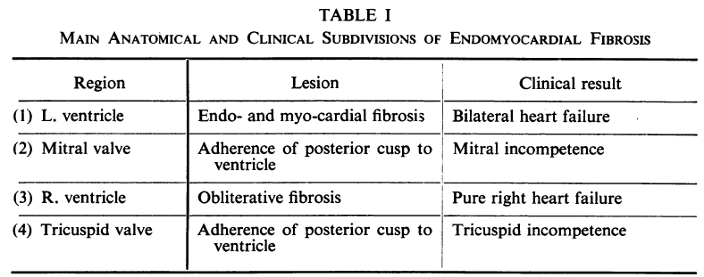

Slide 25
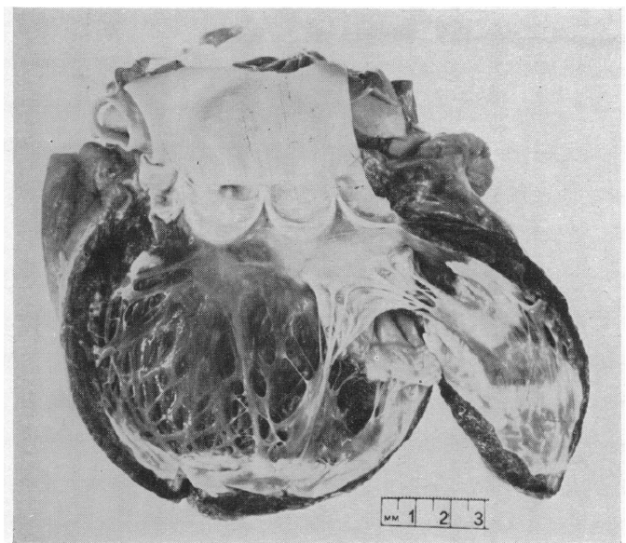

Slide 26
Loffler endocarditis
More aggressive and rapidly progressive
Affects mainly males
Associated with hypereosinophilia, thromboemboli, and systemic arteritis;
EMF occurs in a younger distribution, affects young children, and is only variably associated with eosinophilia.

Slide 27
Hypereosinophilia produces the first phase of endomyocardial disease characterized by necrosis, intense myocarditis, and arteritis (i.e.Loffler endocarditis)
Lasts for a period of months followed by a thrombotic stage a year after the initial presentation
Nonspecific thickening of the myocardium with a layer of thrombus replacing the inflammatory portion of myocardium
Late phase - final healing is achieved by the formation of fibrosis, at which point the clinical features of EMF are present

Slide 28
Role of Eosinophils
Mechanism remains incompletely understood
Have the capacity to directly infiltrate tissues or to release factors that may exert toxicity
Loffler endocarditis have degranulated eosinophils in their peripheral blood
These granules contain cardiotoxic substances, capable of causing the necrotic phase of endomyocardial disease
Leads to the thrombotic and fibrotic phases once the eosinophilia resolves.

Slide 29
Ventricular chamber affected..
Africa – LV – 40%
RV – 10 %
Bi V – 50 %
India - South ( vijayaraghavan etal ) –
RV – 60 %
LV – 20 %
BiV – 20 %
- North (wahi etal ) –
RV – 20 %
LV – 40 %
Bi V – 40 %
Notes:
29

Slide 30
CLINICAL MANIFESTATIONS
Depends on the ventricle affected, the duration of disease
Related to the presence of right and/or left heart failure.
LV EMF
  Dyspnea on exertion
  Paroxysmal nocturnal dyspnea
  Orthopnea

Slide 31
RV EMF
Presents with chronic systemic venous hypertension
Leads to
  Exophthalmos, elevated jugular pressure
  Gross hepatomegaly
  Ascites
  Lower extremity, and abdominal swelling
Chronic thromboembolism may lead to pulmonary hypertension
Notes:
Both rv n lv-50
Lv 40
Rv 10

Slide 32
Ascites may or may not be accompanied by other signs of right-sided heart failure, such as elevated jvp or lower extremity edema
Barretto AC, Mady C, Oliveira SA, et al. Clinical meaning of ascites in patients with endomyocardial fibrosis. Arq Bras Cardiol 2002; 78:196.
High prevalence of malnutrition and hypoalbuminemia may explain the predilection for ascites in this population
Ascites is not fully explained by congestion since the fluid is an exudate with predominance of lymphocytes
Thought to be due to peritoneal inflammation and reduced reabsorption of peritoneal fluid caused by fibrosis
Notes:
edema [35-38

Slide 33
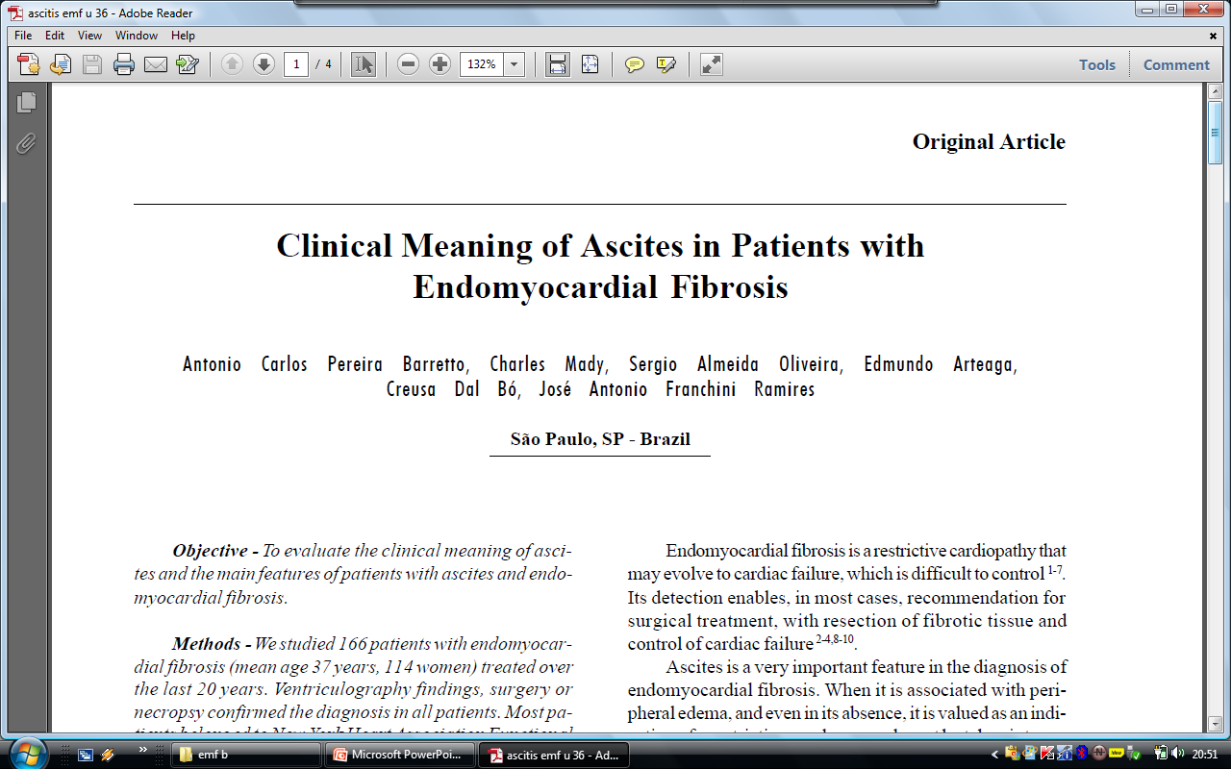
Objective - To evaluate the clinical meaning of ascites and the main features of patients with ascites and EMF
Studied 166 patients with EMF (mean age 37 years, 114 women) treated over the last 20 years
Ascites was present in 67 (41.8%) patients
RV involvement was present in 59 (88%)

Slide 34
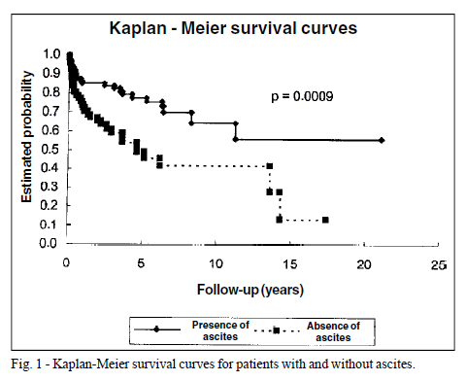
Those with ascites had
  Higher mortality (49.2% and 24.7%)
  Higher incidence of edema (95% vs. 43%)
  Hepatomegaly (5.8cm vs. 4.1cm)
  Mean right atrium pressure (19.3 vs. 12mmHg)
  Longer history of illness (5.1 and 3.9 years, respectively)
  Atrial fibrillation more frequently (44.7% vs. 30.1%)
Conclusion
Ascites was observed in less than
50% of cases of EMF & was associated with
  Greater involvement of RV
  Longer duration of the disease
  Characteristic of a worse prognosis

Slide 35
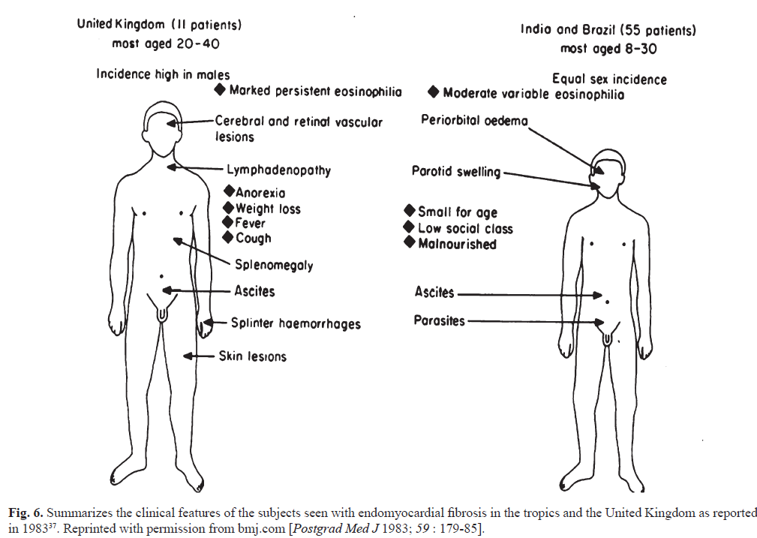
A comparison of the clinical and cardiological features of endomyocardial disease in temperate and tropical regions
J. DAVIES ,G. VIJAYARAGHAVAN et al A comparison of the clinical and cardiological features of endomyocardial disease in
temperate and tropical regions,1983.

Slide 36
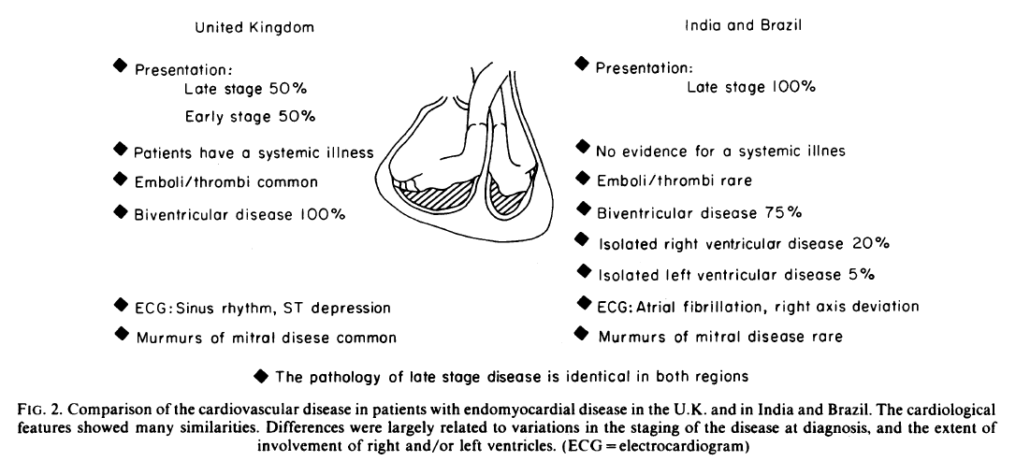
J. DAVIES ,G. VIJAYARAGHAVAN et al A comparison of the clinical and cardiological features of endomyocardial disease in
temperate and tropical regions,1983.

Slide 37
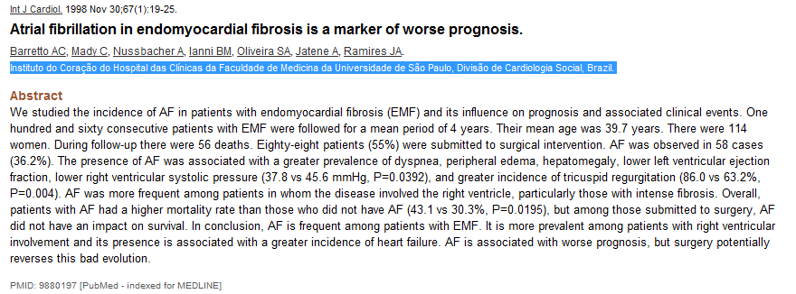
studied the incidence of AF in patients with endomyocardial fibrosis (EMF) and its influence on prognosis and associated clinical events
Notes:
Atrial fibrillation is common in end-stage disease and predicts a poor prognosis

Slide 38
160 consecutive patients with EMF were followed for a mean period of 4 years (114 women)
During follow-up there were 56 deaths
88 (55%) were submitted to surgical intervention
AF was observed in 58 cases (36.2%)
AF was associated with a greater prevalence of
  dyspnea, peripheral edema, hepatomegaly
  lower LV ejection fraction
  lower RVSP (37.8 vs 45.6 mmHg, P=0.0392)
  greater incidence of TR (86.0 vs 63.2%, P=0.004)

Slide 39
AF is frequent among patients with EMF
More prevalent among patients with RV involvement and is associated with a greater incidence of heart failure
AF is associated with worse prognosis

Slide 40
Clinical course
The early part of the disease is rarely clinically recognized in India and the disease comes to attention in the late stages
Davies described three phases of the disease in his patients from Uganda
Initial phase - acute carditis phase, characterized by febrile illness and in severe cases with heart failure and shock

Slide 41
Those who survive this acute illness, progress into a sub acute phase followed by a chronic phase
Most of the patients come to clinical attention in this chronic burnt-out phase
Once clinically diagnosed, the onset of complications like atrial fibrillation, thrombo-embolism, and progressive atrioventricular valve regurgitation abbreviates the natural history

Slide 42
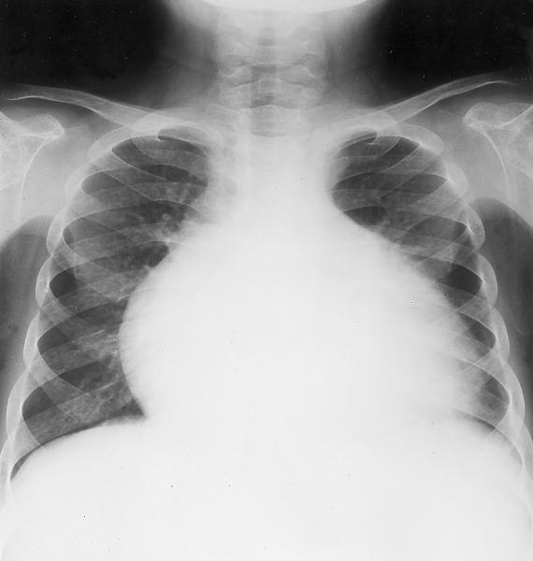
CXR
On chest radiographs,esp. in RVEMF the heart is always enlarged in the transverse diameter, and often it is enormous.
This may be due to a coexisting pericardial effusion, but is usually due to a dilated, almost aneurysmal right atrium.
If pericardial fluid is scanty there will be an outflow tract convexity, which on fluoroscopy or ultrasound is seen to be very active.

Slide 43
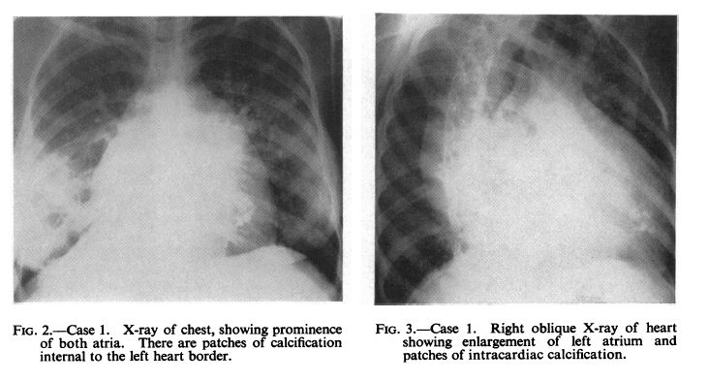
In late cases there may be an oblique, linear calcification at the elevated apex of the right ventricle or base of the pulmonary conus .
The lung fields are strikingly oligemic and, because of low cardiac output, the superior vena cava and azygos veins are very prominent.
In LV EMF , myocardial calcification and pulmonary congestion may be seen with a moderate cardiomegaly

Slide 44
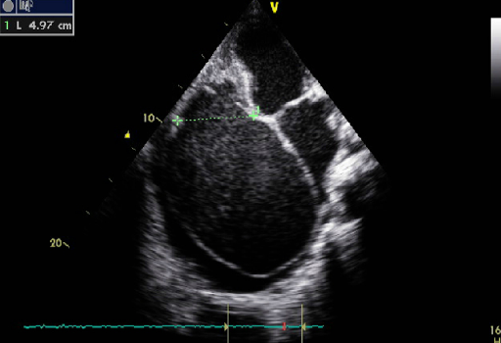
Echo features
Apical fibrosis of the RV, LV, or both ventricles
Tethering the AV valve papillary muscles, leading to mitral and/or tricuspid regurgitation
Giant atrial enlargement
A restrictive filling pattern
on Doppler recordings
of mitral valve inflow
Notes:
obliteration of the right ventricle with reduction of cavity volume, tricuspid annulus dilatation,
aneurismal right atrium with spontaneous contrast. There is compression of the left cavities,

Slide 45
Apical 4 chamber view showing RV apical fibrosis with an appearance of a mushroom
”.
Notes:
In right ventricularEMF, the trabecular portion of the ventricle is separated from the remaining cavity by a large fibrotic endocardial
plaque, underneath which there is myocardium of apparently normal texture [11]. This large fibrotic plaque obliterating the apex of the ventricle giving a typical appearance of mushroom and designated as “mushroom sign” which is a classical feature of EMF in echocardiography

Slide 46
pulling of the wall by the retracted tricuspid valve apparatus, resulting in the distinctive finding of advanced right sided EMF called “apical notch” .
The “apical notch” gives the heart a shape that resembles the map of Africa, hence the designation “Heart of Africa”
Tilted apical four chamber view showing RV apical fibrosis, thick and calcified moderator band, apical notch on the RV wall simulating the description as “African heart
Notes:
The progressive fusion of trabeculae
between the thickened endocardium and epicardium results in retraction of the ventricular cavity. There is a reduction in the distance between the epicardium and the false floor and this process is associated with pulling of the wall by the retracted tricuspid valve apparatus, resulting in the distinctive finding of advanced rightsided
EMF called “apical notch” . The “apical notch” gives the heart a shape that resembles the map of Africa, hence the designation “Heart of Africa”

Slide 47
Merlon sign- hypercontractile basal ventricle opposing an obliterated apex.
Diastolic bulge of iv septum into the LV .
Left ventricular apex is never retracted, it becomes thicker leading to considerable reduction of the longitudinal diameter of the ventricle, resulting in a spherical ventricular cavity.
The fibrotic process of EMF involves the atrioventricular (AV) valve and sub-valvular apparatus and masquerading as rheumatic heart disease in endemic areas for both diseases.
In chronic rheumatic heart disease, leaflet thickening is usually restricted to the tip of the valve, extends to the chordae, and is not associated with obliteration of the ventricle.
Outflow tracts of the ventricles and semilunar valves are spared from the disease process of EMF.
Notes:
The fibrotic retraction of the right ventricular apex produces the typical apical dimple

Slide 48
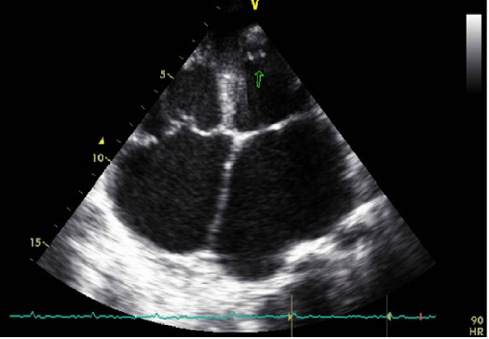
Apical thrombi are often present
Apex maintains inward systolic contractile motion
Help to differentiate EMF from other causes of apical thrombi associated with an akinetic or dyskinetic apex such as myocardial infarction or Chagas disease

Slide 49
Echo staging
An echocardiographic screening study in Mozambique included echocardiographic criteria for the diagnosis and staging of EMF
A definite diagnosis of EMF was made in the presence of two major criteria or one major + two minor criteria
A total score of
  Less than 8 - mild EMF
  8 to 15- moderate disease
  More than 15 - severe disease.

Slide 50
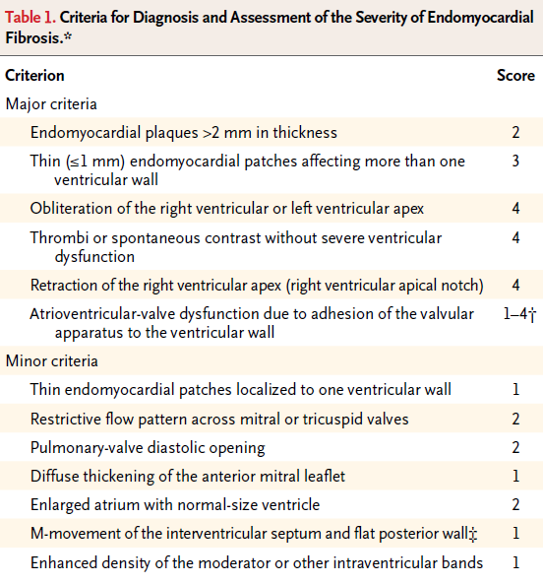

Slide 51
Cardiac catheterization
Not required for the diagnosis of EMF
Depending on ventricle involved, MR and TR may be demonstrated
Ventricular angiography reveals apical obliteration of the affected ventricle
Notes:
(image 2) [43].

Slide 52
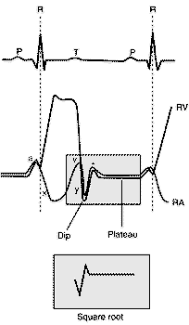
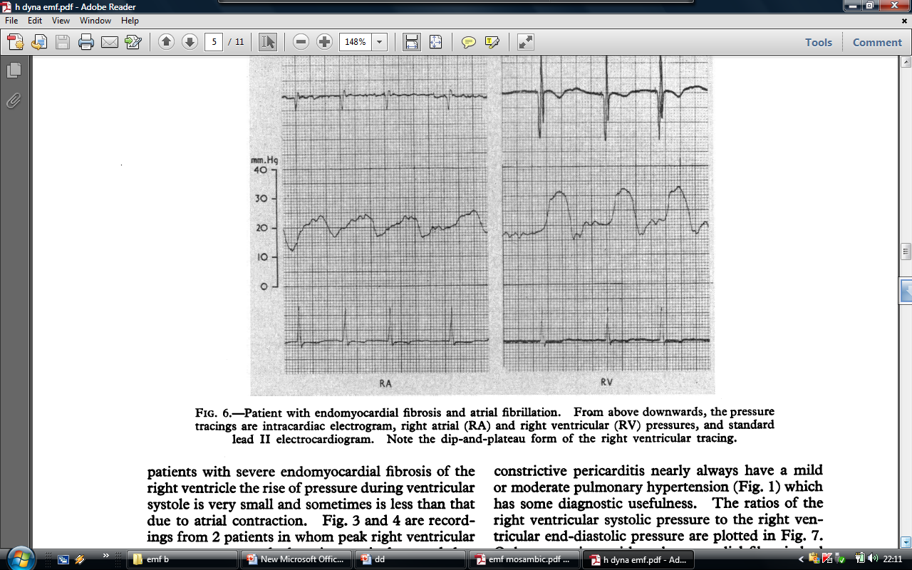
Diastolic dip and plateau
hemodynamic studies - restrictive pattern with diastolic dip and plateau pressure tracings
Notes:
The typical haemodynamic finding on cardiac catheterization is the dip and plateau pattern of restrictive ventricular filling, which does not show pressure equalization between ventricles, unlike constrictive pericarditis.

Slide 53
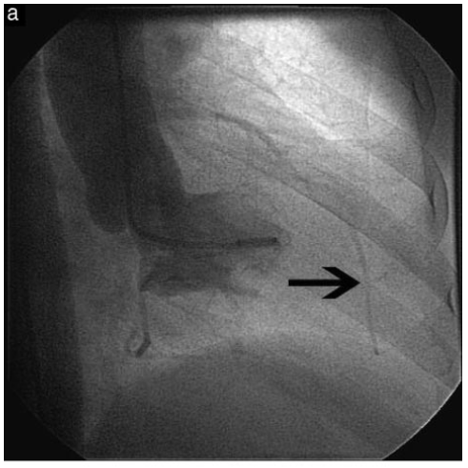
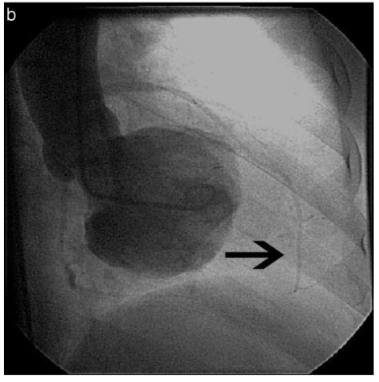
Angiography
Characteristic obliteration of the apex of the involved ventricle(s) with varying degree of AV valve regurgitation
Left ventricular angiogram in the RAO view showing obliteration of the apex in systole and diastole
Walid M. Hassan, MD, FCCP; Mohamed et al Pitfalls in Diagnosis and Clinical, Echocardiographic, and Hemodynamic Findings in Endomyocardial Fibrosis A 25-Year Experience 2005
Notes:
Angiography
characteristic obliteration of the apex of the involved ventricle(s) with varying degree of AV valve regurgitation in all patients with left ventricular
or biventricular EMF
. In patients with right ventricular involvement, there was obliteration of the right ventricular apex with dilation of the outflow tract. right ventricular inflow and outflow with obliteration

Slide 54
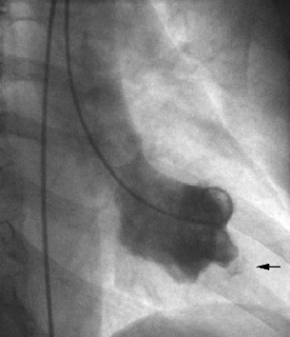
Clenched Fist appearance

Slide 55
Cardiovascular magnetic resonance imaging
CMR imaging with contrast demonstrates myocardial fibrosis
Generally unavailable in areas with highest burden of disease
Early disease where there is suspicion for active inflammation, CMR may be useful in identifying patients who may benefit from steroid therapy.
Notes:
(image 3) [44,45].

Slide 56
Echo may not fully differentiate EMF from other cardiac diseases presenting as LV apical obliteration such as
  Apical HCM
  Cardiac tumors
  Apical thrombus
  Noncompaction

Slide 57
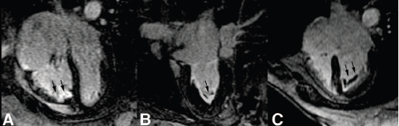
CMR provides detailed information on ventricular morphology and function excellent visualization of the ventricular apex
Late gadolinium enhancement (LGE)-CMR allows the evaluation of the presence of myocardial inflammation, fibrosis, and injury
Precise EMF diagnosis and evaluation of fibrosis may allow surgical intervention in a less advanced stage
Vera M.C. Salemi et al Circ Cardiovasc Imaging 2011

Slide 58
PROGNOSIS AND MANAGEMENT
Natural history of EMF is not fully defined, and there are few data available to guide therapeutic decisions
Most present to medical care with end-stage disease
Annual mortality - as high as 25 percent despite medical treatment
Barretto AC, Mady C, Nussbacher A, et al. Atrial fibrillation in endomyocardial fibrosis is a marker of worse prognosis. Int J Cardiol 1998; 67:19.
Surgical management has led to long-term survival in some patients with EMF
Moraes F, Lapa C, Hazin S, et al. Surgery for endomyocardial fibrosis revisited. Eur J Cardiothorac Surg 1999; 15:309
This option is unavailable in regions with a high disease burden

Slide 59
Medical therapy
Diuretics and rate control for atrial fibrillation are currently the mainstays of therapy
Pleural, pericardial or ascitic fluid removal may alleviate symptoms, but these often reaccumulate
In patients with suspected acute carditis, prednisone may be of benefit

Slide 60
Surgery
Endomyocardial resection with valve replacement or repair has gained prominence at many centers, especially in subjects in advanced heart failure
Moraes F, Lapa C, Hazin S, et al. Surgery for endomyocardial fibrosis revisited. Eur J Cardiothorac Surg 1999; 15:309
Schneider U, Jenni R, Turina J, et al. Long-term follow up of patients with endomyocardial fibrosis: effects of surgery. Heart 1998; 79:362.[6,47,
Immediate postoperative mortality is high, ranging from 15 to 30 percent, but surgery offers the possibility of long-term survival
A surgical series of 83 patients from Brazil all in NYHA functional class grade III-IV, and with a mean follow-up of 7.6 years had a survival probability at 17 years of 55 percent

Slide 61
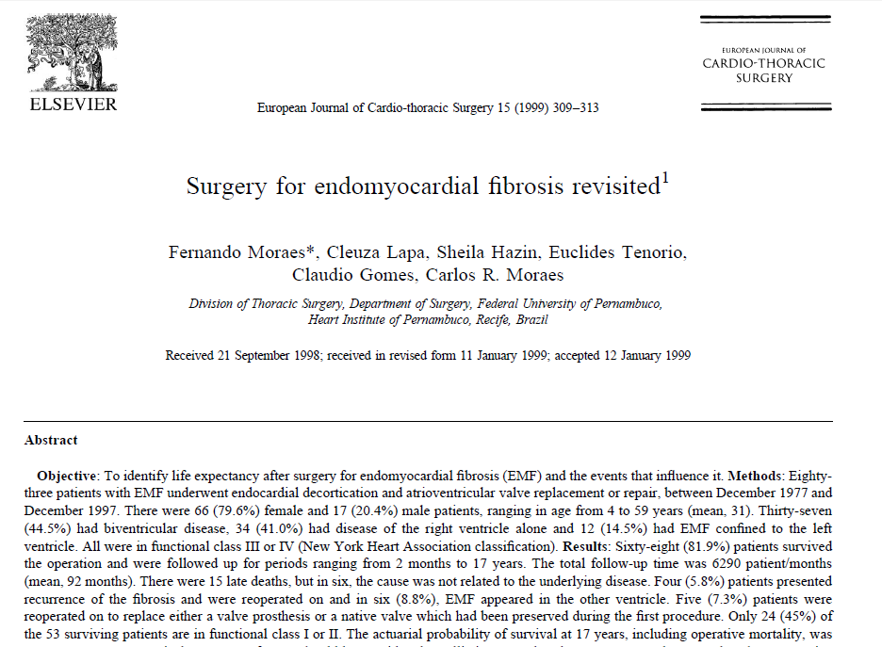
To identify life expectancy after surgery
83 patients with EMF underwent endocardial decortication and AV valve replacement or repair (1977 - 1997)
66 (79.6%) female and 17 (20.4%) male
Ranging in age from 4 to 59 years (mean, 31)
37 (44.5%) - BVEMF
34 (41.0%) - RV EMF
12 (14.5%) - LV EMF
All were in functional class III or IV NYHA

Slide 62
Sixty-eight (81.9%) patients survived the operation and were followed up for periods ranging from 2 months to 17 years
There were 15 late deaths, but in six, the cause was not related to the underlying disease
4 patients had recurrence of the fibrosis and were reoperated
In 6 EMF appeared in the other ventricle
Only 24 (45%) of the 53 surviving patients are in functional class I or II
Actuarial probability of survival at 17 years, including operative mortality, was 55%

Slide 63
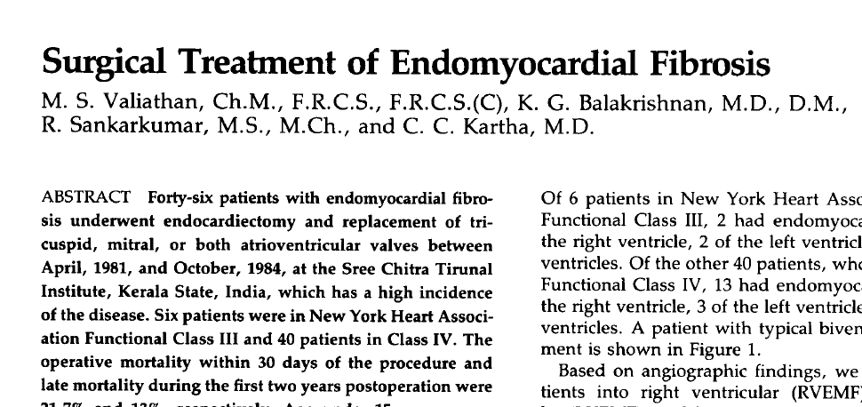

Slide 64
46 patients with EMF underwent endocardiectomy and AV valve replacement 1981- 1984 Sree Chitra Tirunal Institute
Six patients in NYHA 111 and 40 in Class IV
operative mortality within 30 days of the procedure - 21.7%
late mortality during the first two years postoperation - 13%
Survival inclusive of operative mortality at two years was 67%

Slide 65
Published series have been small, overall experience is limited, and questions remain about the appropriate timing, peri-operative mortality, and long-term prognosis
Cardiac surgery is not routinely available in areas with high EMF prevalence.

Slide 66
Changing natural history of EMF
Gupta and colleagues defined the natural history of the disease in Kerala in the late 1980s
Follow up of the initial 200 patients showed a 10 year survival of only 37 per cent
Ascites, atrial fibrillation and NYHA class IV were the poor prognostic indicators
89 patients, who underwent endocardiectomy with mitral valve replacement had an actuarial survival of 55 per cent during the same period
Gupta PN, Valiathan MS, Balakrishnan KG, Kartha CC, . Ghosh MK. Clinical course of endomyocardial fibrosis. Br Heart J 1989; 62 : 450-4.

Slide 67
Significant decline in the number of new cases happened in the hospital admissions in Kerala in the subsequent decades
Natural history in them was more favourable with less than 10 per cent mortality on seven years follow up
Average number of cases seen declined by half in the last decade, compared to the previous decade

Slide 68
There are no patients below 10 yr, whereas in the previous decade, 28 per cent were below the age of 15 yr.
Patients are less symptomatic and older
Majority are incidentally diagnosed when evaluated for electrocardiographic or echocardiographic abnormalities.

Slide 69
The period noted in natural history studies belong to 30 year period of 1976 to 2007
During the same period, Kerala witnessed substantial economic, nutritional and health transition
The per capita calorie consumption increased from 1600 to 2100 Kcals
Nutritional deficiency disorders were replaced by those of overnutrition
Health status of Kerala is acclaimed as an example for good health at low cost
A community survey shows that there is a substantial decline in worm load per child

Slide 70
Future directions…
The prevalence of FIP1L1-PDGFRa in pts with EMF could give another important clue
The fusion protein FIP1L1-PDGFRa, a constitutively activated tyrosine kinase found in as many as half of those with the idiopathic hypereosinophilic syndrome
emerged as a therapeutic target for imatinib
Cools J, DeAngelo DJ, Gotlib J, Stover EH, Legare RD, Cortes J, et al. A tyrosine kinase created by fusion of the PDGFRA and FIP1L1 genes as a therapeutic target of imatinib in idiopathic hypereosinophilic syndrome. N Engl J Med. 2003;348:1201-14.

Slide 71
THANK YOU

Slide 72
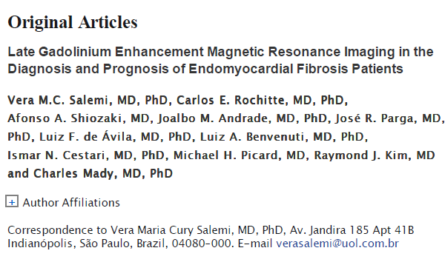

Slide 73
There was a relation between increased FT/body surface area and worse New York Heart Association functional class and with increased probability of surgery .
The histopathologic examination of resected FT showed typical features of EMF with extensive endocardial fibrous thickening, proliferation of small vessels, and scarce inflammatory infiltrate.
In multivariate analysis, the patients with FT/body
surface area >19 mL/m had an increased mortality rate, with a relative risk of 10.8.

Slide 74
This is one of the rare disorders where spontaneous evolution of Fontan physiology is illustrated
Fontan physiology is characterized by elevation of the mean systemic venous pressures above the diastolic pulmonary artery pressures.
initial reports of right ventricular endomyocardial fibrosis were discussed as “isolated systemic venous hypertension”.
The classical features of this isolated systemic venous hypertension include dilated hepatic veins, which show minimal inspiratory collapse, significant elevation of jugular venous pressure with prominent atrial waves, stretching open of the foramen ovale, which leads to right to left shunting and central cyanosis with clubbing.

Slide 75
Methods and Results—Thirty-six patients (29 women; age, 54±12 years) with EMF diagnosis after clinical evaluation and comprehensive 2-dimensional Doppler, echocardiography underwent cine-CMR for assessing ventricular volumes, ejection fraction and mass, and LGE-CMR for FT characterization and quantification.
Indexed FT volume (FT/body surface area) was calculated after planimetry of the 8 to 12 slices obtained in the short-axis view at end-diastole (mL/m ).
Surgical resection of FT was performed in 16 patients.
In all patients, areas of LGE were confined to the endocardium, frequently as a continuous streak from the inflow tract extending to the apex, where it was usually most prominent.

Slide 76
